Slide 1

Senority
GENPACT
introduction to
Rotterdam, April 2012

Slide 2

Introducing Senority
Founded by a group of people with deep experience in the services industry who collectively have been challenged over the years because there is no simple "solution" that can help complex client supplier relationships
We have identified the gap, validated the demand, determined the scope and mobilized industry experts and developed Evaluetor^{tm}
The mission of Senority is to assist outsourcing companies in Improving customer retention, for that we have created a solution that consists of 3 “pillars”
Evaluetor^{tm}
Software solution, the secret sauce
Secure processes in a workbench enabling integrated management
Process templates
We can Lead or Follow, your choice
Using experience driven proven processes
Advisory group
Strength in Knowledge
Experienced advisors that help your organisation with the process framework

Slide 3
Experience in implementing
Rob van Leeuwen (1960), managing partner, has a wide experience in both Managing Service Organizations, and selling and shaping Outsourcing contracts. He has been an independent Sales – and IT Consultant over the past 9 years and has worked on both the customer and the vendor side of Service Excellence. Rob is a firm believer in successful strategic partnerships based on a foundation of transparency and trust.
Steven Visser (1956), Managing Partner, has a vast experience in out-sourcing in various industry sectors. Focused on creating mutual beneficial value propositions thus creating successful and sustainable business relationships. Experienced in all aspects of outsourcing both as client and supplier, including deal structuring, negotiations, HR process, technical solution validation, and (multi supplier) governance models Been Instrumental in closing more than 15 B$ TCV, Largest single transaction deal 2.4B$ in 57 countries, redesigned 40.000 FTE European Services organisation, successfully managed a 1B$ annual sales target.
Steve Koutros (1955), Managing Partner is a senior executive who brings a broad global vision of successfully and profitably managing businesses, people and IT through experiences acquired in Europe and the United States. Experienced through extensive industry and consulting experience covering oil & gas, manufacturing, wholesale distribution and pharmacy. Seasoned team builder and fire fighter who can lead an organization as COO down to building process models and strategy design.
Enrico de Boer (1965), managing partner, has a wide experience in selling and shaping of sourcing contracts in various industry sectors, managing IT Service organizations and consulting practices.. His experience includes all aspects of sourcing, i.e. deal structuring, negotiations, HR, solutioning and governance models. Enrico started his career in 1987 as a professional and grew into several management positions. Great believer that everybody is connected, where business models are based on alliances.

Slide 4
Senority provides...
Senority helps service providers to improve customer satisfaction, thus realizing
Higher renewability rate
Higher growth of wallet share
Higher referenceability
By implementing our Evaluetor software and :
a process for obtaining an objective transparent view of the account
Internal status of the account
Voice of the customer
a process for defining and monitoring customer improvement plans
Improvement actions
Owners
Deadlines
a process for managing contractual agreements
Contract reviews
Obligations
Risks
an account dashboards for management
Account status
Alerts (contract & relationship)
Escalations

Slide 5

To help you install and sustain a client driven continuous improvement process, we implement Evaluetor©.
This will bring insight and visibility on the quality of your services and the perception thereof. Delivery will be tuned to achieve optimal Customer Satisfaction using a collaboration platform.
Use of Evaluetor© will enable:
Shared dash-boarding;
Internal perception recording;
Client perception measurement;
Early identification of issues and opportunities;
Structured improvements;
Pro-active governance;
Automated contract alerts;
Key performance indicator monitoring;
Real time relationship monitoring.
De-risked backlog
Improved collaboration several entities and clients
Reliable revenue predictions;
One way of working, Culture change, first time right attitude
Focused on the client;
Transparent Client relationship with aligned expectations; increase of Net Promoter Score
Trusted relation
One corporate “language”;
Making informed decisions
More contract renewals
Increase references (Promoters)
De-risked portfolio
More revenue with existing clients
Decrease operational cost

Slide 6
Hands-on Benefits using the collaboration platform Evaluetor©.
Including:
Secure all communication including email
Secure and store all client intelligence
Central location for all information agreed including Master Service agreements, Statement of Works, Contract schedules available for all key stakeholders on an account;
Alerts configured in the contract and / or additional schedules
Central storage of historical data including Governance documents, financial reports, press releases, proposals etc.

Slide 7

Evaluetor© Delivers Value Every Day
Services (SLA) Management
Evaluetor^{tm} equates reality with perception, negotiations with contract operationalization
Senority’s Management Portal for managing complex services, simply
Service
Performance
Indicators
Contract
Event
Action
Log
Contract
Management
Improvement Management
Relationship Management
Contract
Performance
Indicators
Key
Performance
Indicators
Project
Status
Indicator
Designed to increase sustainability of best practice implementations
Project Management
Tailored and configured to
Genpact’s
requirements

Slide 8
How the information comes together….
Evaluetor Dashboard
Contract performance
Improvement
Plan Status
Contracts
Upload
Contracting (client & supplier)
Go to Green status collection
Services Metric collection (SLA)
Delivery Performance
Project
Metric
Collection
Alerts
Account Staff
Delivery Staff
Account Team Score
Client Score
Client Interview
Web based Survey
Perception based
Fact based

Slide 9
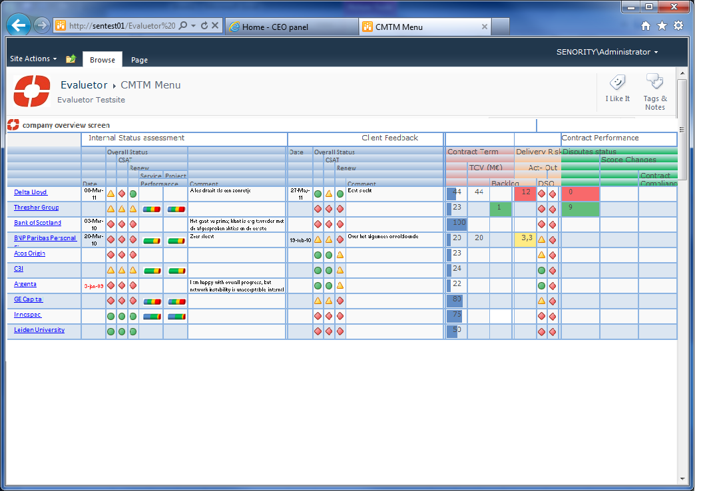
Management Dashboard

Slide 10
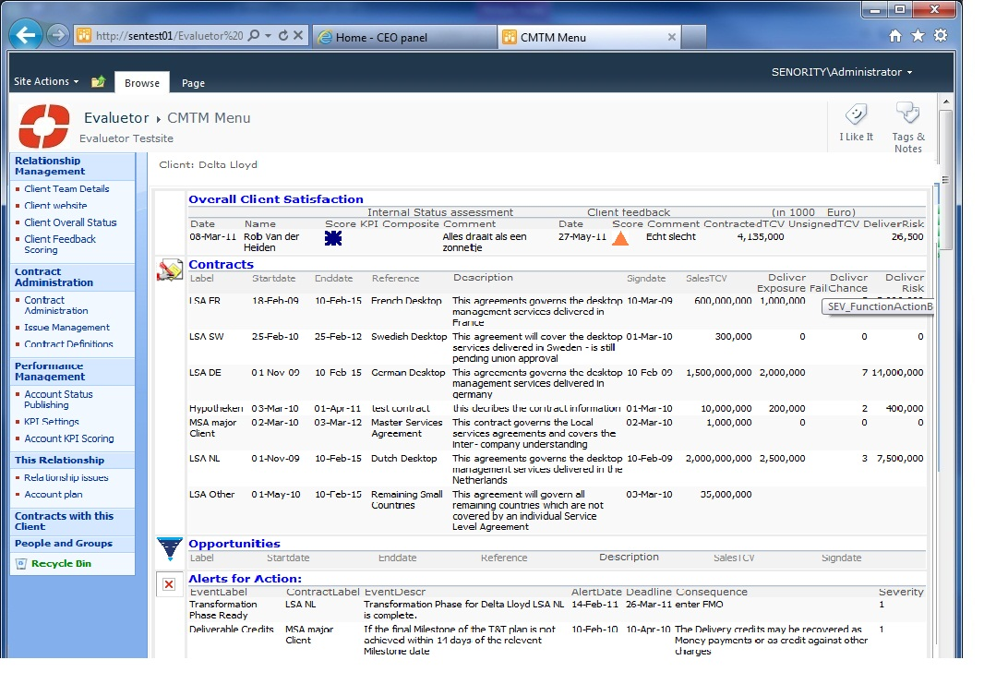
Contract alerts overview

Slide 11
Evaluetor© Value
Companies that have implemented Service Excellence have:
Case-1 : only 18 months after initiation of our program:
Increased the Outsourcing Recommendation Index with 14 points;
Increased the number of Promoters of our client with 21%;
As a result we have de-risked 11% of their revenue;
And recorded a 6% growth of add-on business within the existing customer portfolio.
Case-2 : results after 3 year:
Customer retention increased from 53% to 82%;
Increase of referenceability with 20%;
Increase win rate with 10%;
Decrease of operational cost of 5%.

Slide 12
Senority proposition to GENPACT
Implement Evaluetor including the following configuration process:
Prepare – introduce best practises and pilot environment
Enter the Pilot client (i.e. Staples) contract(s) with alerts on agreed Contract Performance Indicators into our software solution Evaluetor.
Account status
Customer improvement planning
Voice of the customer
Management dashboards
Software support for Senority practices
Optional:
Apply Senority account improvement processes as a show case on the Pilot client
Baseline - create improvement plan
30 day’s - Agreed Go to Green plan
60 day’s - measure improvement
90 day’s - closedown of go to green
Result:
Delivering a closer and more intimate Client
relationship that is:
Transparent
Honest
Both parties (GENPACT and Client) deliver on agreed commitments
Pro-active
Immediate action when required

Slide 13
In Summary
Benefits:
Integrated relationship management approach
Ability to pro-actively manage contract conditions and risks
Automatic prompts contract conditions
Continuous improvement based on actual issues and observations
Dedicated focus on “go-to-green” improvement actions
High level overview of all contract- and relationship statuses with ability to drill down to actual underlying issues
Full transparency of day-to-day status of strategic customer relationships
Customer/revenue driven improvement focus
Clear roles, responsibilities and ownership for relationship responsibilities
Intercompany communication vehicle
Business value
Increase yield of contracted value by 5%
Improve customer satisfaction by 15%
Reduce operational cost by 5 %
Increase renewal rate and reference(ORI) with 20%

Slide 14
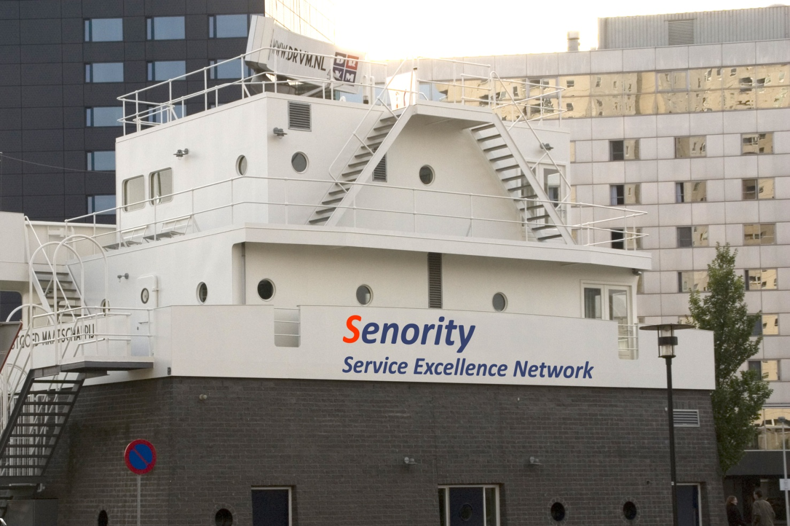
Contact
Enrico de Boer Managing Partner Boompjes 680 3011 XZ Rotterdam
The Netherlands Tel: +31 (0) 10 217 0118 Fax: +31 (0) 10 213 0133 Mobile: +31 (0) 6345 17 696 enrico.deboer@senority.nl www.Senority.nl

Slide 15

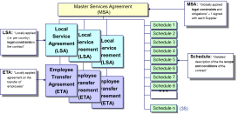
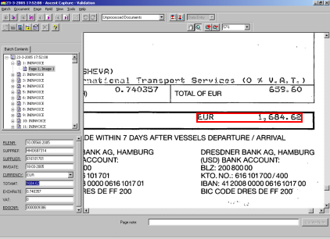


How to get your existing contracts into Evaluetor
Contract documents are tagged with relationship attributes
Enrich DB with contract details
Analise contract clauses and register relevant Alerts
Contract documents
Evaluetor
DB
Digitise
Categorise
Enrich
Add Alerts
Scan and/or copy contract documents into Evaluetor Document Library
Electronically relate contracts and associated schedules per relation
Add first level information like end date, type of services, etc.
Add contract specific information that will help manage the contract more effectively

Slide 16
Account improvement main process
Integrate in company DNA
Internal perception Client relationship
Execute and Monitor
Improvementplan
Obtain
Client
Feedback
Overall satisfaction
Responsiveness
Problem resolution
Customer focus
Reference
Contract renewal
Create
Improvement
plan
Identify
Improvement Areas

